Slide 1
Design patterns

Slide 2
What & Why
“Design patterns are recurring solutions to design problems”
“Design patterns are proven solutions approaches to specific problems”
Common language
Best practice from others experience

Slide 3
Types
Creational patterns
Structural patterns
Behavioral patterns

Slide 4
Creational
Factory method
Abstract Factory
Singleton
Builder
Prototype

Slide 5
Creational
Factory method
Abstract Factory
Singleton
Builder
Prototype

Slide 6
Structural
Adapter
Bridge
Composite
Decorator
Facade
Flyweight
Proxy

Slide 7
Behavioral
Chain of Responsibility
Command
Interpreter
Iterator
Mediator
Momento
Observer
State
Strategy
Template
Visitor

Slide 8
Design Principles
“Separate what varies from what remains constant”
“Prefer composition over inheritance”
“Program to interfaces over implementation”

Slide 9
problem
Implement a dictionary
Add functionality
  search
  sort

Slide 10
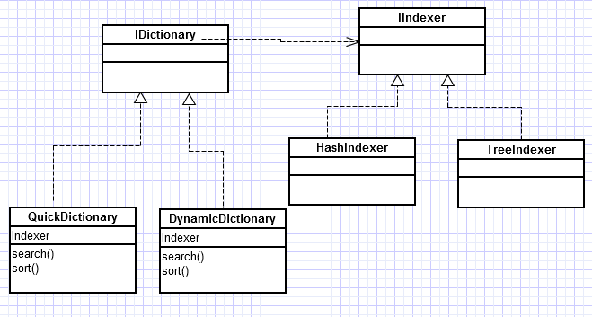
Strategy Pattern
Defines a set of algorithms
Makes them interchangeable
clients have the option to select
Comparator from java is one example of strategy

Slide 11
Problem
A bank software for maintaining Account
Interface to account
  ATM
  Online
  Manual
Design Principle : “Strive for loose coupling”

Slide 12
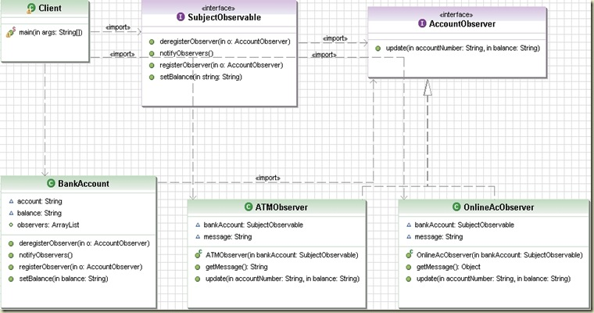
Observer Pattern:
One object’s state changes need to notify all its dependents
Java has in-built support check Observer/Observable

Slide 13
Problem
Implement a Juice maker machine, which can make juice with following ingredients
  Water
  Milk
  Orange/Lime
  Sugar
Design Principle: ”classes should be open to extension – closed to modification “

Slide 14
Decorator
Water

Slide 15
Problem
Implement a computer shop which can create
A computer based on customer requirement
How can it be implemented ?
Design Principle “loose coupling, separate what changes from what is constant“

Slide 16
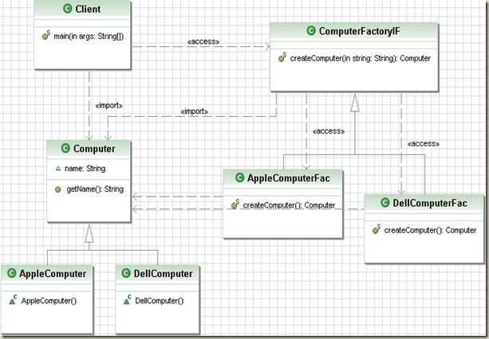
Factory Method
Provides an interface for creating related objects
Without knowing concrete classes

Slide 17
Problem
Implement a computer shop which can create
A computer based on customer requirement
How can it be implemented ?
Design Principle “loose coupling, separate what changes from what is constant“

Slide 18
Factory Method
Provides an interface for creating related objects
Without knowing concrete classes

Slide 19
Problem
You need to have only one instance of a class.
And one access point
Across threads

Slide 20
Singleton
Simple implementation
Thread safe
Double check implementation

Slide 21
Problem
Decouple invoker from the receiver
Encapsulation of the method

Slide 22
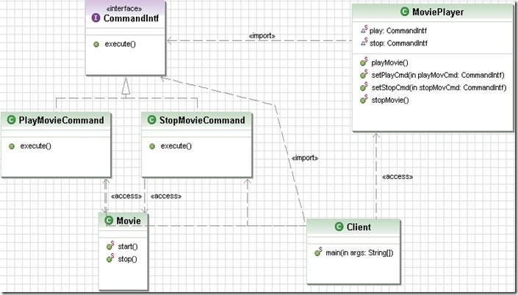
Command Pattern

Slide 23
Problem
A Client who has fixed his interfaces and wont change
A Service which has interfaces implemented and wont change
How do we handle this ?

Slide 24
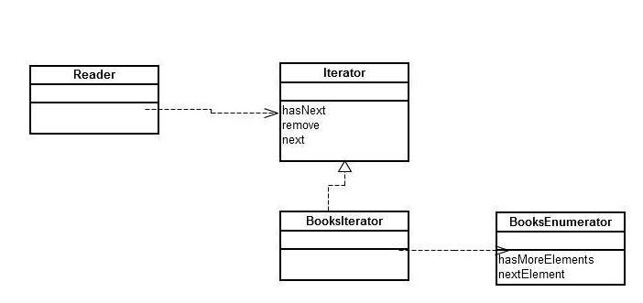
Adapter Pattern

Slide 25
Problem
You have to build a website like makemytrip
Interact with hotels
Interact with travel agencies
Collect money from client
“Design Principle- principle of least knowledge, talk only to your immediate friends”

Slide 26
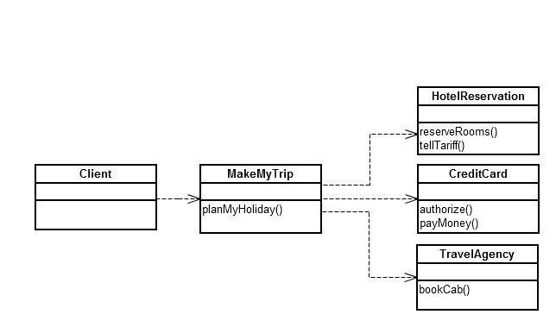
Facade

Slide 27
Problem
implement a Drink Maker with following steps
    Add Water
    Add Fruit
    Add ice
Design Principle : "Don't call us, we will call you"

Slide 28
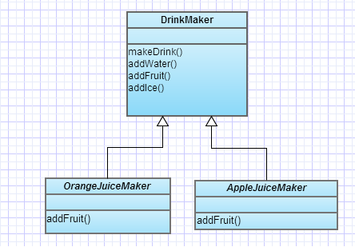
Template Method
Defines the skeleton of the algorithm , and defers some implementation to the sub classes.

Slide 29
Problem
Iterating over an Aggregator
think how iterating all the employees in a company

Slide 30
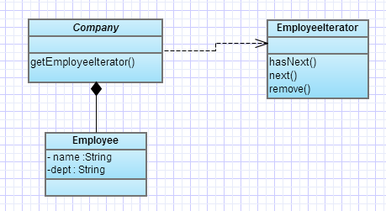
Iterator
single responsibility,
simplifies aggregation
does not expose implementation of aggregator

Slide 31
Problem
Implement a Mobile class which has the following states
LowBattery
  Makecall,charge
FullBattery
  Makecall,charge
ChargingBattery
  Charge,makecall

Slide 32
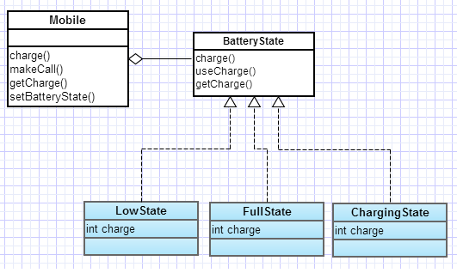
State Design Pattern
It allows to change the behavior of the object when the state of an object changes
How is it different from strategy ?
behavior changes when the state changes , and the state transition is managed by the states.

Slide 33
Problem
You have to control access to an expensive object / which is remote

Slide 34
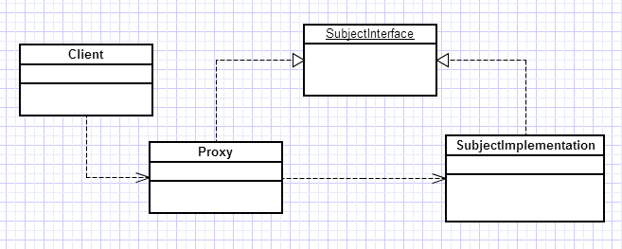
Proxy
Wraps another object to Control access
Hide information about the real object
Can do optimization
Initialization/Clean up activities

Slide 35
References
http://en.wikipedia.org/wiki/Design_Patterns
Head First Design Patterns

